Slide 1

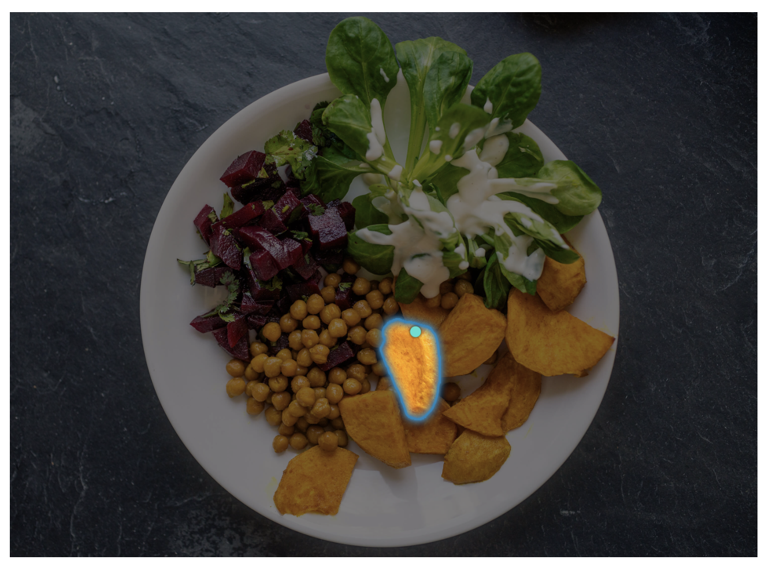
Project Title
Team Name
Sonit Singh (zxxxxxxx)
Hugh Wilson(zxxxxxxx)
Stefano Mezza (zxxxxxxx)
Jingying Gao (zxxxxxxx)
Zhongsui Guo (zxxxxxxx)

Slide 2
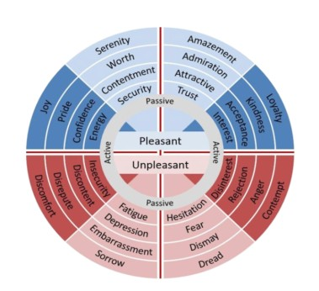
Motivation
Is it possible for Deep Learning Network to recognize different emotions through learning process? How is it expressed?
Emotion Classification: Identifying emotional expressions from tweets
One of the core tasks in NLP
Different areas of applications:
Psychology
Social Engineering
Commercial Feedback
Social Impact Analysis
…
Presenter: Sonit Singh (zxxxxxxx)

Slide 3
Problem Statement
Emotions are expressed in nuanced ways, which varies by collective or individual experiences, knowledge, and beliefs. Therefore, to understand emotion, as conveyed through text, a robust mechanism capable of capturing and modelling different linguistic nuances and phenomena is needed. Hence, the task of this project is to develop deep learning based solutions that can accurately identify emotion presented in textual data.
Presenter: Hugh Wilson (zxxxxxxx)

Slide 4
Literature Review
CARER: Contextualized Affect Representations for Emotion Recognition
They subtract emotional expressions of tweets by subjective graph – objective graph, categorizing tokens to connector words and subject words, and extract patterns which are strongly subjective to be classified.
Presenter: Hugh Wilson (zxxxxxxx)

Slide 5
Dataset(s)
Provide details about the dataset or the RL tasks
Presenter: Hugh Wilson (zxxxxxxx)

Slide 6
Data Analysis
Briefly provide details here …
Presenter: Zhongsui Guo (zxxxxxxx)

Slide 7
Method(s)
Details here …
Presenter: Zhongsui Guo (zxxxxxxx)

Slide 8
Results
Details here …
Presenter: Zhongsui Guo (zxxxxxxx)

Slide 9
Discussion
Details here …
Presenter: Zhongsui Guo (zxxxxxxx)

Slide 10
Conclusion
Write here
Presenter: Zhongsui Guo (zxxxxxxx)

Slide 11

This Photo by Unknown Author is licensed under CC BY-SA

